Slide 1
CCBI and Sensitive Areas Analysis Workshop
February 16, 2023

Slide 2
Reminders
Session is being recorded
Please mute
Enter questions in chat

Slide 3
Agenda
CCBI (Conservation Benefits Indicator)
Robert “Tony” Oesterling, GIS Analyst, Paradigm Systems GIS, Resource Inventory and Assessment Division-SSRA
Sensitive Areas Analysis Demo & Planning Analysis
Travis Rome, National Geospatial Lead
Jason Nemecek, National Soil Data Applications Scientist
CEAP (Conservation Effects Assessment Project) References
Peter Chen, Resource Analytics Lab Coordinator, Resource Inventory & Assessment Division-SSRA
Q & A

Slide 4
Conservation Planning Analysis
Travis Rome
Conservation Planning and Technical Assistance Division
National Geospatial Lead

Slide 5
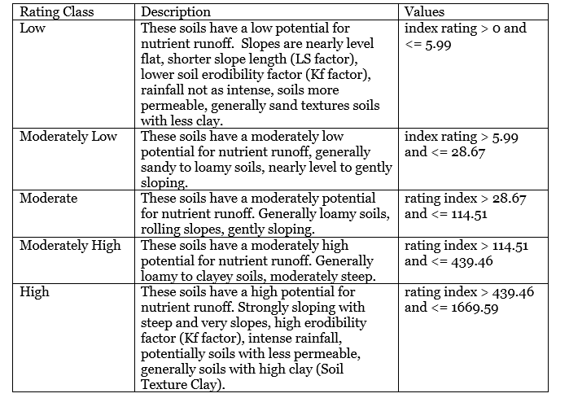
Planning Analysis – Nutrient Loss Runoff Sensitive Areas Soil Ratings
Notes:
Thanks Travis. Hi everyone, my name is Jason Nemecek, my title is the National Soil Data Application Scientist for the Soil and Plant Science Division. My role is to provide national technical soil leadership to Conservation, which includes getting soil data connected to conservation tools.
For the Nutrient Runoff model, there were a lot soil scientists, GIS experts and developers that helped Travis and I build this custom geospatial model. We wanted to make it easy for everyone and automate these rating classes into Conservation Desktop. With this automation, planners have a science-based methodology in their workflow with a visualization. This helps them to make better informed conservation decisions.
This slide shows the breakdown of the rating classes for the Nutrient Runoff based on the inherent soil properties derived from the Soil data and geospatial datasets. What this slide is trying to show is the classes and the descriptions which tries to provide a little more insight of what each class means. It may help someone understand why something might be low or high based on criteria used in the model.
If anyone is interested in learning more, I can provide a more technical document in the chat. Now back to you Travis.

Slide 6
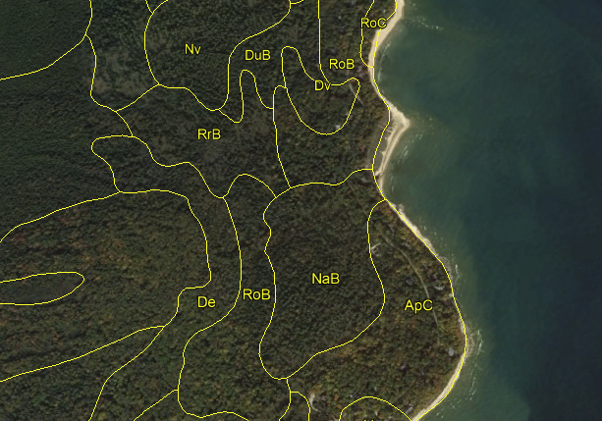
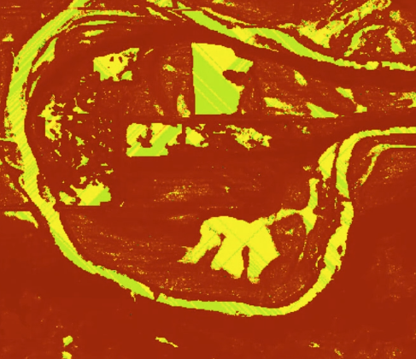
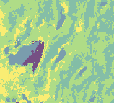
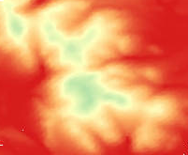

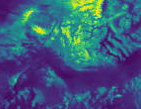
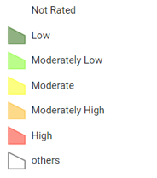
NRCS
Soil Data
Proximal/Remote Sensing Data
Aggregation
Additional soil
Rainfall Factor
Slope
Kw Factor
T Factor
Slope Length
Water Availability
Oxygen Availability
Nutrient Availability
Erosion Hazard
Nutrient Runoff Model
Suitability Classes
Notes:
This is the general process to build a model. Models that use maps are incredibly powerful in telling stories because they connect us to a place. Getting a good map with a story, is complex, the process takes a lot of work. Landscapes have many interconnected processes and changing conditions. Not every process or system is well-known, even after decades of research. With the climate crisis, we can look to technology and high-quality data to help us adapt solutions. NRCS is a geospatial organization and using a geospatial approach to technology. We can enable collaboration across disciplines and assist conservation planning and other land management decision tools. We can take in and store all kinds of data, manage it, analyze it, and make powerful maps with it. Maps mobilize people and decisions since they show location and give context. The conservation planner or producer can connect the map and the information and see what’s happening on the ground. With additional data layers like satellite imagery through AI and machine learning, we harness technology and train models to recognize conservation on the ground. This results in better, more informed decisions.

Slide 7
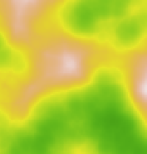
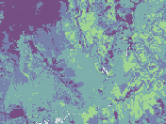
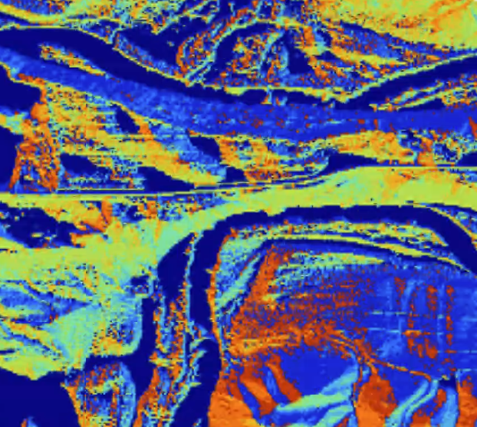

Various
Soil Data
Proximal/Remote Sensing Data
3 Meter Elevation
Aggregation
Derivatives
Additional soil
Stream Power Index
Slope Degrees
Soil Depth
Other Soil Properties
Soil Moisture
Near Real time Precipitation
Flow Direction
Slope Length
Water Availability
Oxygen Availability
Nutrient Availability
Erosion Hazard
Nutrient Runoff Model
Suitability Classes
Notes:
This is the general process to build a model. Models that use maps are incredibly powerful in telling stories because they connect us to a place. Getting a good map with a story, is complex, the process takes a lot of work. Landscapes have many interconnected processes and changing conditions. Not every process or system is well-known, even after decades of research. With the climate crisis, we can look to technology and high-quality data to help us adapt solutions. NRCS is a geospatial organization and using a geospatial approach to technology. We can enable collaboration across disciplines and assist conservation planning and other land management decision tools. We can take in and store all kinds of data, manage it, analyze it, and make powerful maps with it. Maps mobilize people and decisions since they show location and give context. The conservation planner or producer can connect the map and the information and see what’s happening on the ground. With additional data layers like satellite imagery through AI and machine learning, we harness technology and train models to recognize conservation on the ground. This results in better, more informed decisions.

Slide 8
Planning Analysis
Provides that ability to access geospatial information needed to help make conservation planning decisions
Sensitive Area Analysis
WQ Risk for subsurface nitrogen loss by Soil Map Unit
WQ Risk for surface nitrogen loss by Soil Map Unit
WQ Risk for subsurface phosphorus loss by Soil Map Unit
WQ Risk for surface phosphorus loss by Soil Map Unit
WQ Risk for sediment loss by Soil Map Unit

Slide 9
Planning Analysis
Provides that ability to access geospatial information needed to help make conservation planning decisions
Suitability Analysis
Productivity Analysis
Short Leaf Pine Suitability
Long Leaf Pine Suitability
Rangeland Productivity
Crop Productivity Index

Slide 10
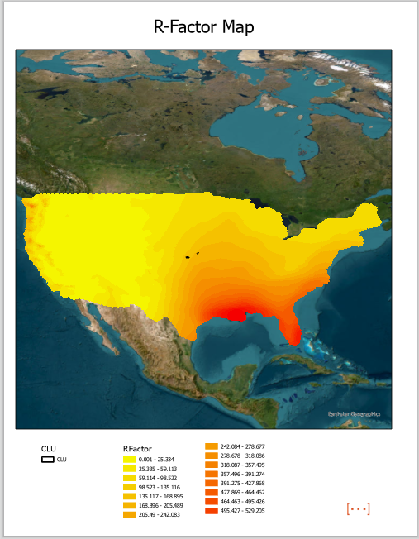
Planning Analysis – Future Modeling Efforts; Rainfall Factor from NOAA

Slide 11
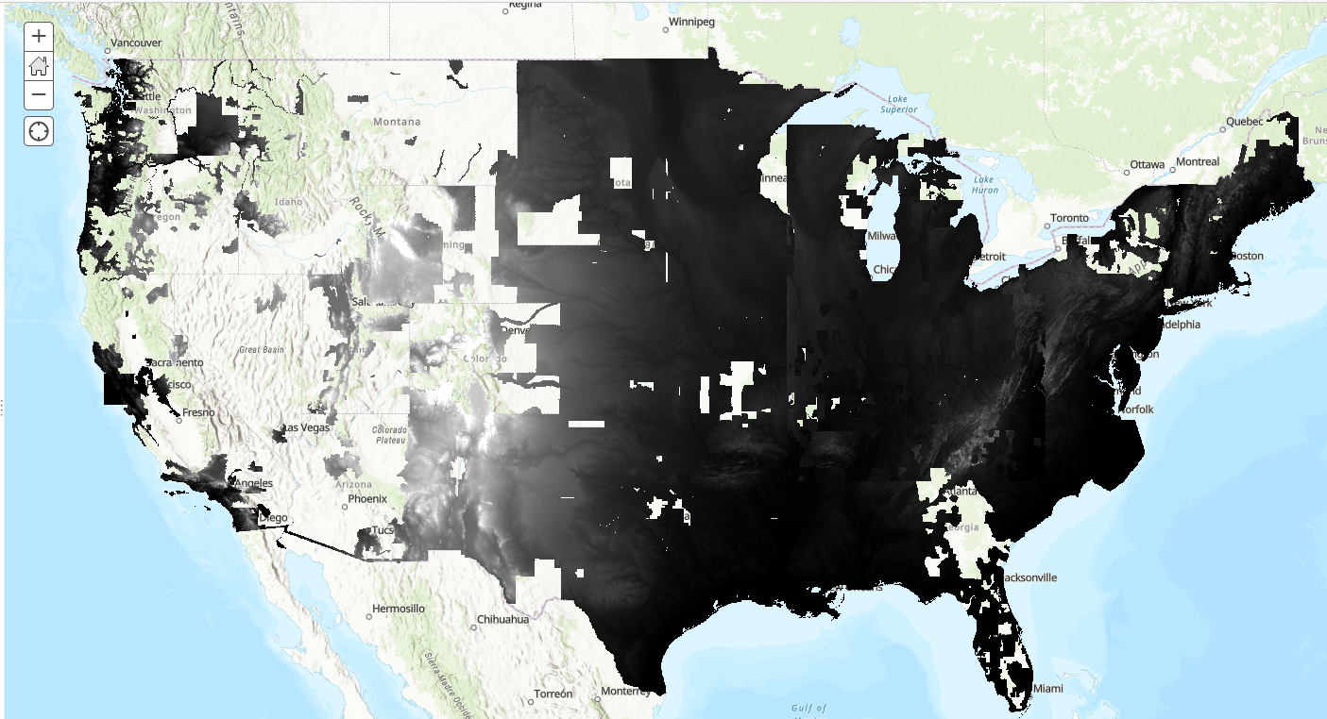
Planning Analysis – Future Modeling Efforts 3m Best available Digital Terrain Model

Slide 12
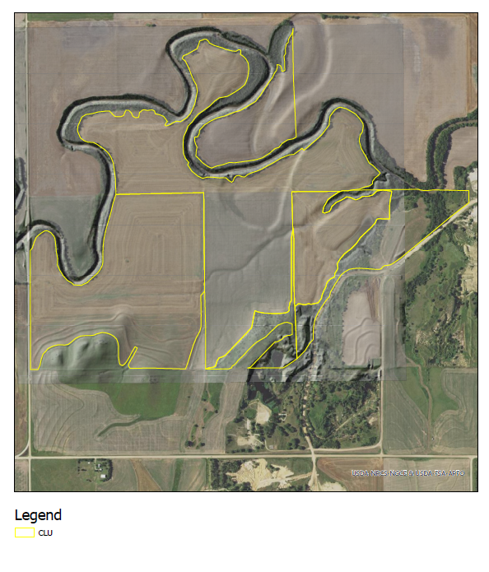
Planning Analysis – Nutrient Loss Runoff Sensitive Areas

Slide 13
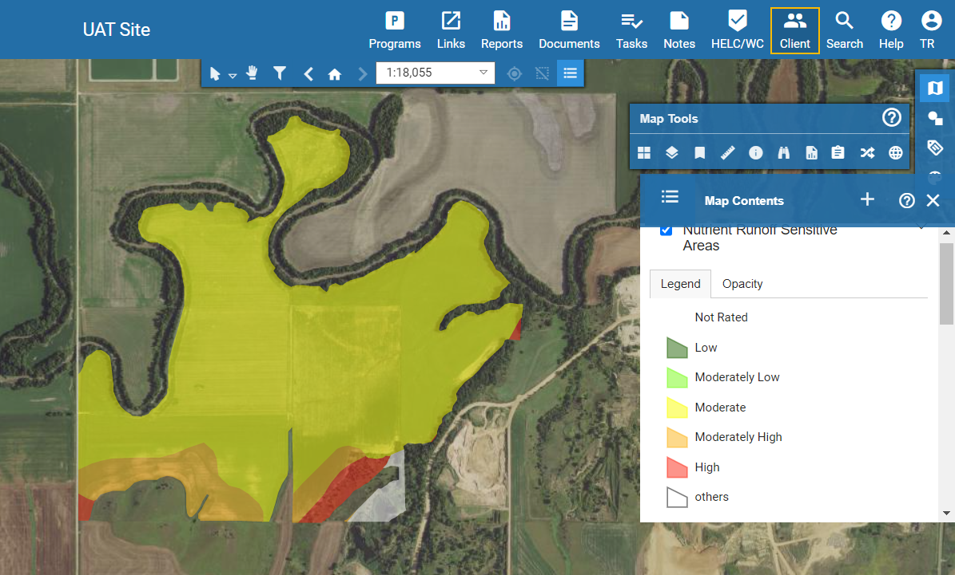
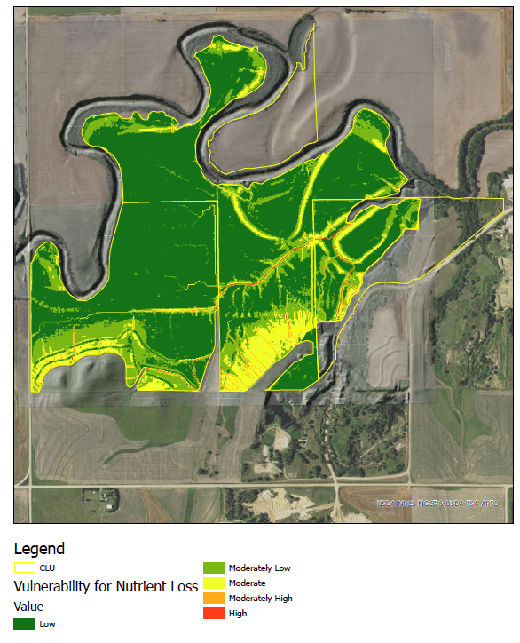
Planning Analysis – Nutrient Loss Runoff Sensitive Areas

Slide 14
Additional CCBI Information
CCBI Field Level Webinar:
CEAP Conservation Benefits Indicator (CCBI) review and webinar-20211014_140044-Meeting Recording
CCBI Field Level User Guide:
https://directives.sc.egov.usda.gov/OpenNonWebContent.aspx?content=47389.wba

